Slide 1
Introduction to MOSFET
Notes:
ELEC 121
January 2004
Introduction to FET's

Slide 2
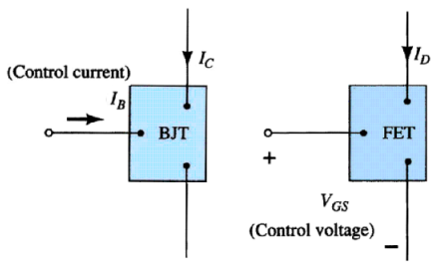
Current Controlled vs Voltage Controlled Devices
January 2004
ELEC 121

Slide 3
MOSFET’s

Slide 4
MOSFETs
MOSFETs have characteristics similar to JFETs and additional characteristics that make them very useful.
There are 2 types of MOSFET’s:
Depletion mode MOSFET (D-MOSFET)
  Operates in Depletion mode the same way as a JFET when VGS ≤ 0
  Operates in Enhancement mode like E-MOSFET when VGS > 0
Enhancement Mode MOSFET (E-MOSFET)
  Operates in Enhancement mode
  IDSS = 0 until VGS > VT (threshold voltage)

Slide 5
MOSFET Handling
MOSFETs are very static sensitive. Because of the very thin SiO₂ layer between the external terminals and the layers of the device, any small electrical discharge can stablish an unwanted conduction.
Protection:
• Always transport in a static sensitive bag
• Always wear a static strap when handling MOSFETS
• Apply voltage limiting devices between the Gate and Source, such as back-to-
back Zeners to limit any transient voltage

Slide 6
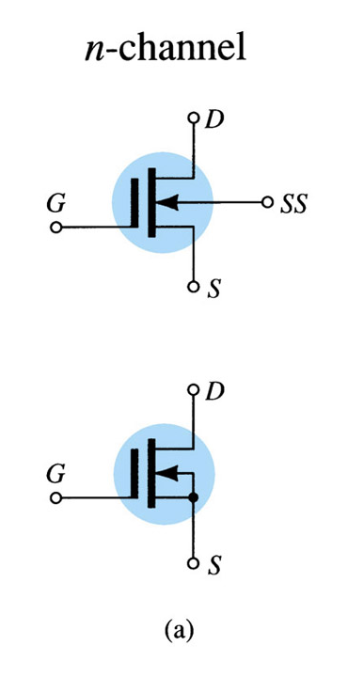
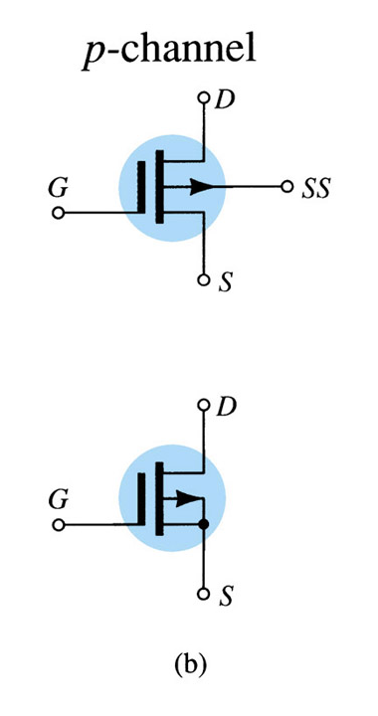
D-MOSFET Symbols

Slide 7
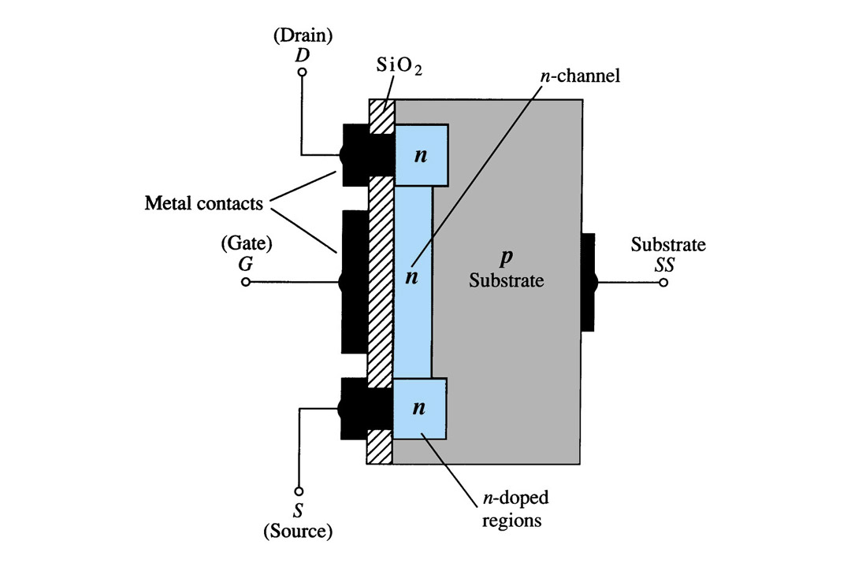
Depletion Mode MOSFET Construction
The Drain (D) and Source (S) leads connect to the to n-doped regions
These N-doped regions are connected via an n-channel
This n-channel is connected to the Gate (G) via a thin insulating layer of SiO₂
The n-doped material lies on a p-doped substrate that may have an additional terminal connection called SS

Slide 8
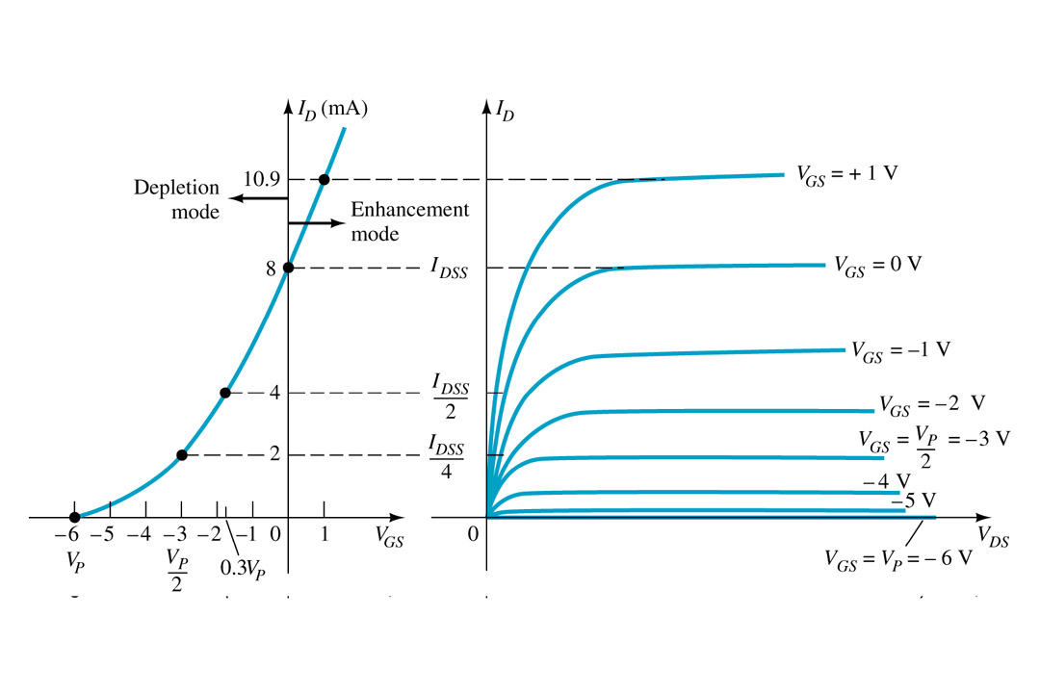
Basic Operation
A D-MOSFET may be biased to operate in two modes:
the Depletion mode or the Enhancement mode

Slide 9
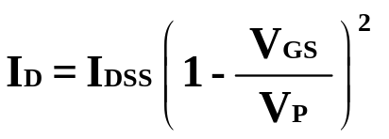
D-MOSFET Depletion Mode Operation
The transfer characteristics are similar to the JFET
In Depletion Mode operation:
When VGS = 0V, ID = IDSS
When VGS < 0V, ID < IDSS
When VGS > 0V, ID > IDSS
The formula used to plot the Transfer Curve, is:

Slide 10
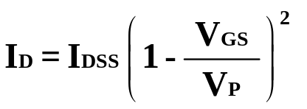
D-MOSFET Enhancement Mode Operation
Enhancement Mode operation
In this mode, the transistor operates with V_{GS} > 0V, and I_{D} increases above I_{DSS}
Shockley’s equation, the formula used to plot the Transfer Curve, still applies but VGS is positive:

Slide 11
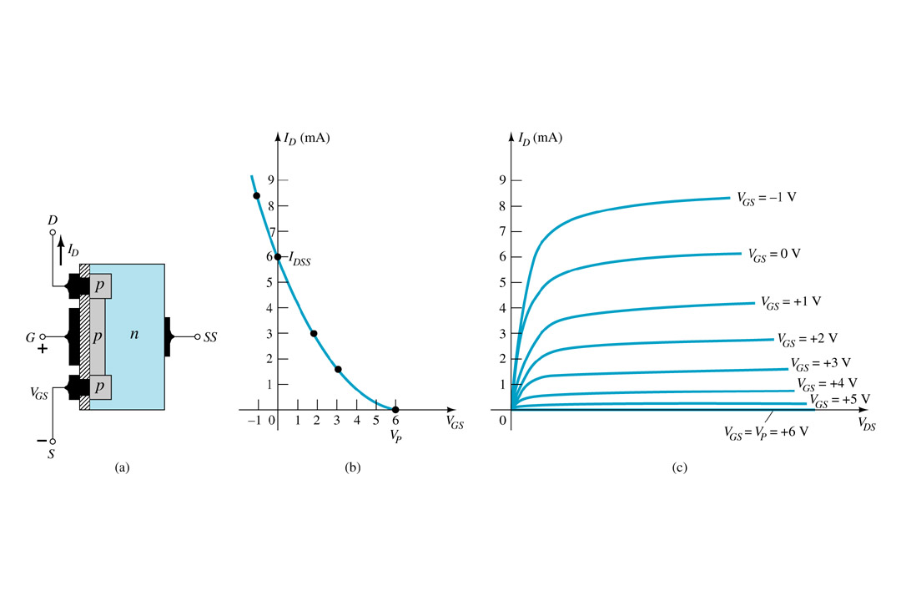
p-Channel Depletion Mode MOSFET
The p-channel Depletion mode MOSFET is similar to the n-channel except that the voltage polarities and current directions are reversed

Slide 12
Enhancement Mode
MOSFET’s

Slide 13
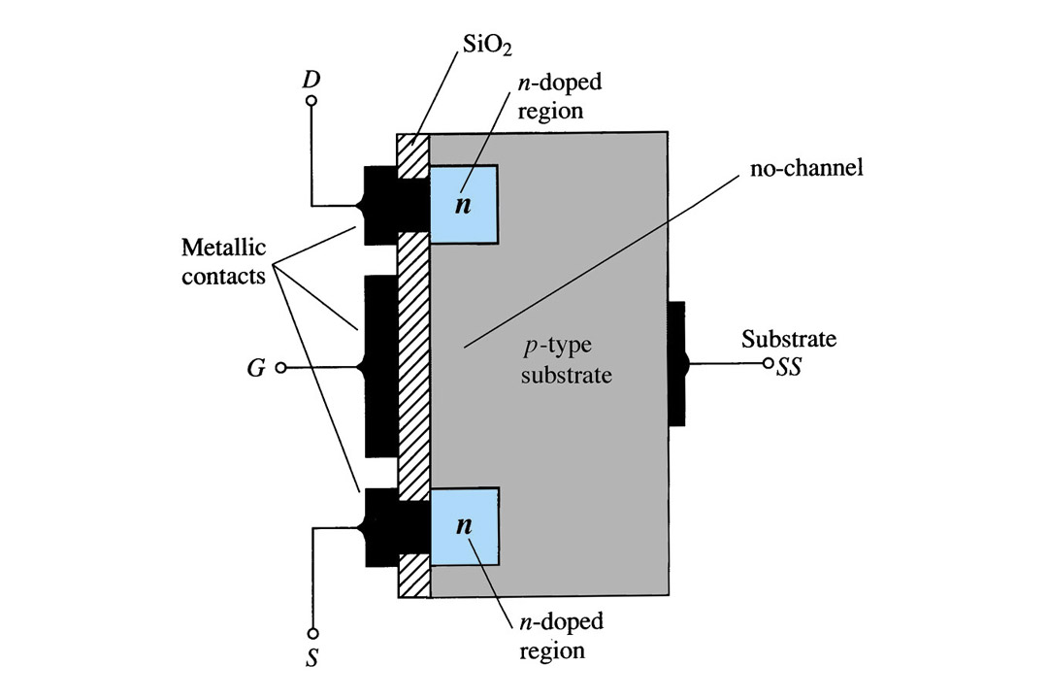
Enhancement Mode MOSFET Construction
The Drain (D) and Source (S) connect to the to n-doped regions
These n-doped regions are not connected via an n-channel without an external voltage
The Gate (G) connects to the p-doped substrate via a thin insulating layer of SiO₂
The n-doped material lies on a p-doped substrate that may have an additional terminal connection called SS

Slide 14
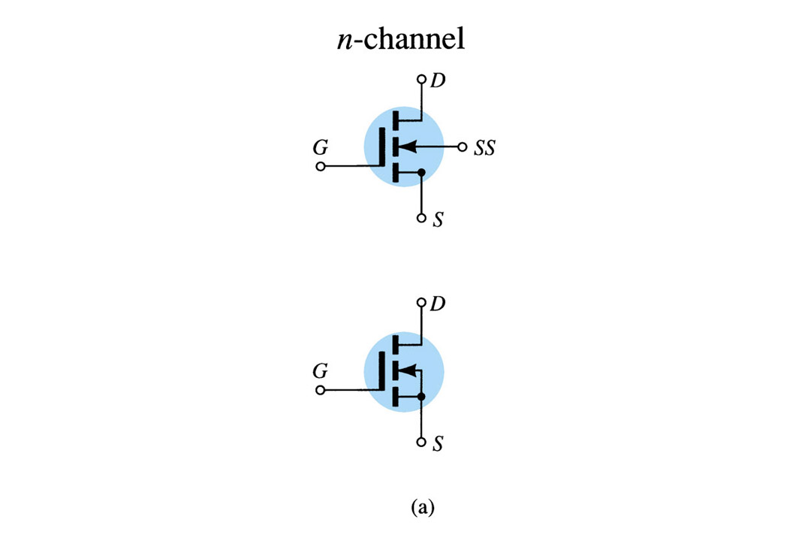
E-MOSFET Symbols

Slide 15
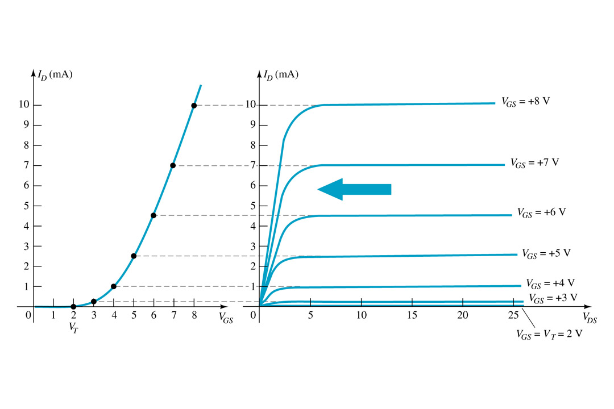
Basic Operation
The Enhancement mode MOSFET only operates in the enhancement mode.
VGS is always positive
IDSS = 0 when VGS < VT
As VGS increases above VT, ID increases
If VGS is kept constant and VDS is increased, then ID saturates (IDSS)
The saturation level, VDSsat is reached.

Slide 16
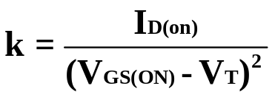

Transfer Curve
To determine ID given VGS:
where VT = threshold voltage or voltage at which the MOSFET turns on.
k = constant found in the specification sheet

Slide 17
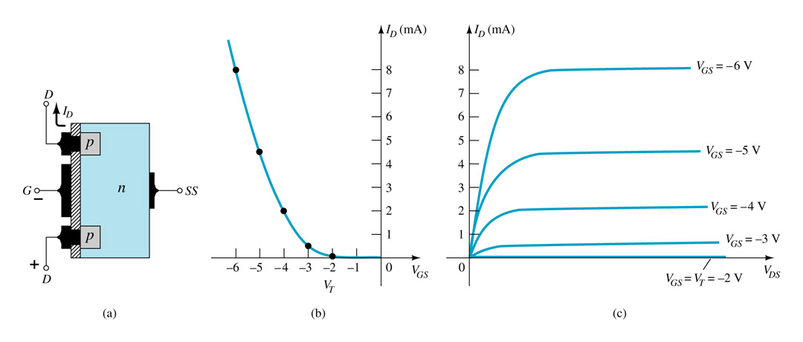
p-Channel Enhancement Mode MOSFETs
The p-channel Enhancement mode MOSFET is similar to the n-channel except that the voltage polarities and current directions are reversed.

Slide 18
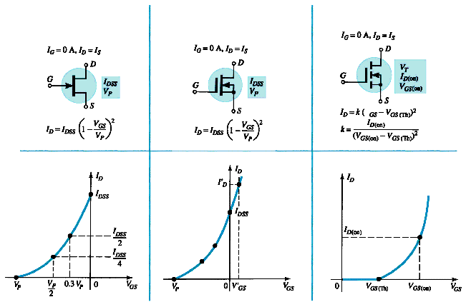
Summary Table
JFET
D-MOSFET
E-MOSFET
Notes:
ELEC 121
January 2004
Introduction to FET's

